Slide 1

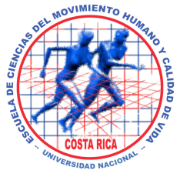
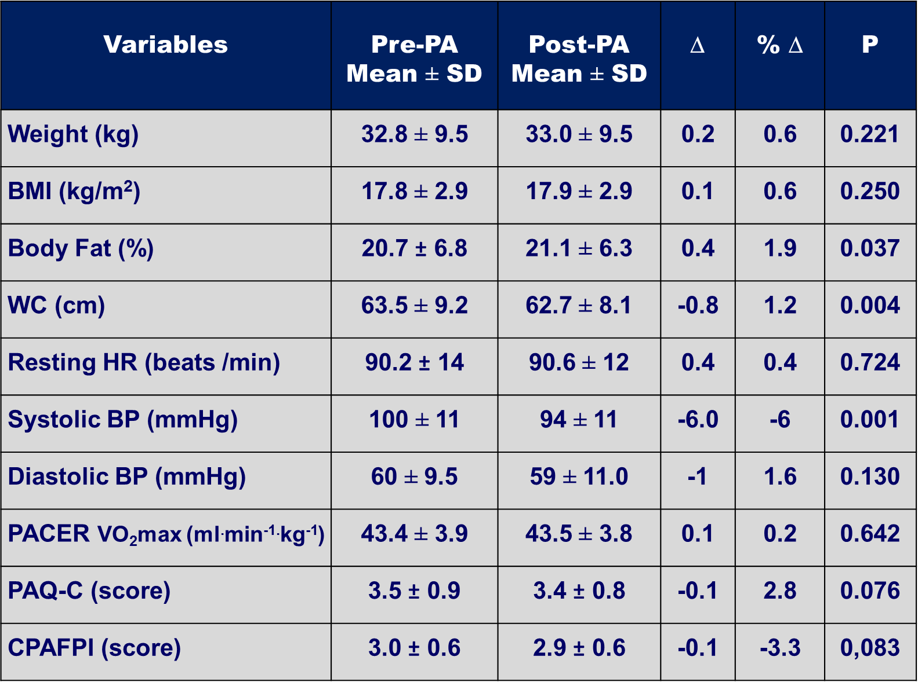

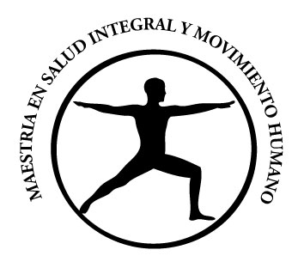
Effect of School-Based Physical Activity on Health Fitness in Children
Insert your Logos
F. Araya-Ramírez, Ph.D.¹⁻², I. Revuelta-Sánchez, MBA.¹⁻², M. Morera-Castro, Ph.D.¹ and C. Carranza-Torre, MBA.²
¹School of Human Movement Science and Quality of Life, Universidad Nacional, Heredia, Costa Rica
²Exercise is Medicine, Costa Rica
Introduction
Overweight and obesity in children have increased dramatically in recent years, both in developed as well as in developing countries such as Costa Rica.¹⁻² According to the Costa Rica National Nutrition Survey (2008-2009), the prevalence of overweight and obesity is alarming. Children aged 5 to 12, presented 11.8% overweight and 9.6% obesity, with girls slightly more obese than boys, 10.1% and 9.2% respectively.² Childhood obesity has been associated with a higher risk of non-communicable diseases (NCDs) and physical inactivity is a risk factor for obesity and NCDs. Children who are overweight or obese, have an increased risk of developing traditional coronary risk factors such as hypertension, high cholesterol
and diabetes mellitus.³ School-based physical activity (PA) programs have proven to improve health and fitness as well as reduce obesity in children, which will probably result in a lower risk of NCDs during adulthood.⁴ The evidence also indicates that the best primary strategy for improving the long-term health fitness of children and adolescents through PA, can be to create and implement lifestyle models that last during adulthood, in which regular PA is a key factor. The PA Guidelines for Americans indicate that children should perform 60 minutes or more of daily PA and that most of it, should be of moderate or vigorous intensity. In addition, people who cannot meet these minimum recommendations can benefit from less PA.⁵
School-based Physical Activity Program
The school-based PA program (Active Flag Program) consisted in the implementation of a model in which a series of directed PA routines were designed and executed on a daily basis during the five school days, 15 minutes per day at a low and moderate intensity. The model as well as the routines, were designed by an EIM member, and the physical education (PE) school staff was trained in order to implement the model which included directing all the routines as well as other activities regarding promotion of PA for the school community. The PA routines were carried out by all students as well as school staff, officials and parents who were invited to participate; all of them simultaneously active in the central school yard. The Active Flag Program also contemplated the design and application of some complementary actions aimed at promoting healthy lifestyles.
Statistical Analysis
All data was analyzed using SPSS statistical package, version 21.0. Descriptive statistics are presented as means and standard deviation (M ± SD). Paired T-Test was used to compare variables of interest (weight, BMI, Body fat. WC, HR, SBP, DBP, PACER, PAQ-C AND CAPAFPI) at the beginning and after completing a six-week PA program. Statistical significance was set a priori at p ≤ 0.05.
Result(s)
Table 1. Baseline Characteristics of Children. Values are expressed as means + 1 standard deviation. Abbreviations: yrs., years; BMI, Body Mass Index; WC, waist circumference; HR, heart rate; BP, blood pressure; PACER, Progressive Aerobic Cardiovascular Endurance Run; PAQ-C, Physical
Activity Questionnaire for Older Children; CPAFPI, Pictorial Physical Activity Questionnaire for Infant.
Children significantly decreased SBP by 6% from (100 ± 11 to 94 ± 11 mmHg, p <.001) and decreased WC 1% from (63.5 ± 9.2 to 62.7 ± 8.1 cm, p = .004). Body fat increased 0.4% from (20.7 ± 6.8 to 21.1 ± 6.3%, p = .037). Children did not show significant changes in BW, BMI, HR, DBP, VO₂max and physical activity levels reported in the questionnaires.
Table 2. Differences between pre-and post anthropometric, physiological variables and questionnaires scores of the children. Values are expressed as means + 1 standard deviation. Abbreviations: yrs., years; BMI, Body Mass Index; WC, waist circumference; HR, heart rate; BP, blood pressure; PACER, Progressive Aerobic Cardiovascular Endurance Run; PAQ-C, Physical Activity Questionnaire for Older Children; CPAFPI, Pictorial Physical Activity Questionnaire for infant.
Conclusion
Children decreased SBP and WC after the six-week school-based physical activity program with no improvement in body composition, aerobic capacity and physical activity levels. Findings from this study support small improvement in some health fitness components of children with 15 minutes per day at a low or moderate intensity physical activity.
Objective
To examine the effect of a school-based physical activity program on health fitness in children.
Variables | N | Cohort | Minimum | Maximum
Age ( yrs.) | 227 | 8.8 ± 1.8 | 6.0 | 13.0
Weight (kg) | 227 | 32.8 ± 9,5 | 16.5 | 65.8
BMI (kg/m²) | 227 | 17.8 ± 2.9 | 11.9 | 27.8
Body Fat (%) | 226 | 20.7 ± 6.8 | 7.6 | 42.7
WC (cm) | 218 | 63.5 ± 9.2 | 47 | 117
Resting HR (beats/min) | 226 | 90 ± 14 | 44 | 131
Systolic BP (mm Hg) | 226 | 100 ± 11 | 72 | 139
Diastolic BP (mm Hg) | 226 | 60 ± 9.5 | 40 | 99
PACER VO2max (ml/kg/min) | 60 | 43 ± 3.9 | 36 | 51
PAQ-C (score) | 84 | 3.5 ± 0.9 | 1.0 | 4.9
CPAFPI (score) | 220 | 3.0 ± 0.6 | 1.0 | 4.0
Methods
A total of 227 children (116 men and 111 women), age = 8.8 ± 1.8 years, height = 1.35 ± 0.12 m, weight = 32.8 ± 9.5 kg, BMI = 17.8 ± 2.9 kg/m², waist circumference (WC) = 63.5 ± 9.2 cm, systolic blood pressure (SBP) = 100 ± 11 mmHg, diastolic blood pressure (DBP) = 60.0 ± 9.6 mmHg and resting heart rate (HR) = 90 ± 14 bpm completed a six-week school-based physical activity (PA) program. Children were assessed before (Pre) and after (Post) the PA program on health fitness components such as body fat, HR, SBP, DBP, Progressive Aerobic Cardiovascular Endurance Run (PACER) and completed the Physical Activity Questionnaire for older children (PAQ-C) and the Pictorial Physical Activity Questionnaire for Infant (C-PAFI).
Anthropometric and Physiological Measurements
Resting HR, SBP and DBP were measured by the same technicians after remain comfortably seated for five-minutes using a standardized protocol. SBP and DBP were measured using a automatic sphygmomanometer (Citizen, model HEM-710) with appropriate cuff size for each children. Then, BW and body fat were measured using a (Tanita BC554 Ironman, Arlington Heights, IL 60005 USA), where the children wearing PA clothing and shoes removed. WC were obtained using a waist tape measure where children were on standing position, arms at the sides, feet together and abdomen relaxed. The measurement was taken horizontal above the umbilicus and below the xiphoid process.
.
Acknowledgements
St. Jude School, Costa Rica
References
1. Flynn, M.A., McNeil D.A., Maloff, B., Mutasingwa D., Wu, M., Ford C. & Tough S.C. (2006). Reducing Obesity and
Related Chronic Disease Risk in Children and Youth: a Synthesis of Evidence with "Best Practice"
Recommendations. Obesity Review. 2006, 7 (1): 7-66.
2. Ministerio de Salud (2010). Encuesta Nacional de Nutrición 2008-2009, San José, Costa Rica.
3. Daniels, S.R., Jacobson, M.S., McCrindle, B.W., Eckel, R.H. & Sanner, B.M. American Heart Association Childhood
Obesity Research Summit: executive summary. Circulation. 2009 21;119 (15): 2114-23.
4. Dobbins, M., Husson, H., DeCorby, K. & LaRocca, R.L. School-based physical activity programs for promoting
physical activity and fitness in children and adolescents aged 6 to 18. Cochrane Database of Systematic Reviews.
2013, 28 (2): 1-260.
5. U.S. Department of Health and Human Service. 2008 Physical Activity Guidelines for Americans. Washington, DC.
CONTACT INFORMATION
Felipe Araya-Ramírez, Ph.D. e-mail: felipe.araya.ramirez@una.cr
Inés Revuelta-Sánchez, MBA. e-mail: ines.revuelta.sanchez@una.cr

