Slide 1

Guess the Word!!

Slide 2
Topic:
School Life around the World

Slide 3
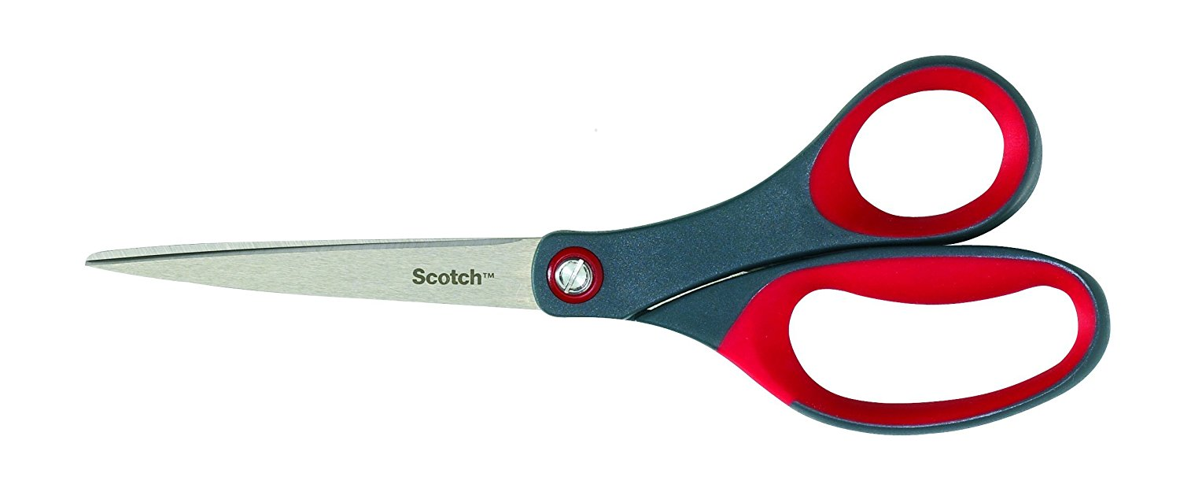
SCISSORS

Slide 4

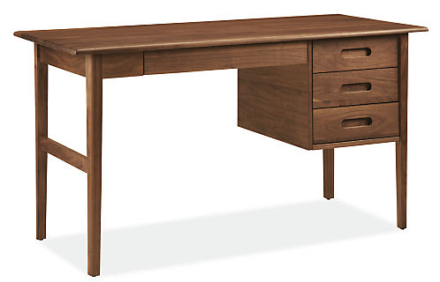
DESK

Slide 5

TEACHER

Slide 6

STUDENTS

Slide 7

MATH

Slide 8

GEOGRAPHY

Slide 9

LANGUAGES

Slide 10

ERRASER

Slide 11

SCHOOL

Slide 12


COLLEGE

Slide 13

BOOKS

Slide 14

NOTEBOOK

Slide 15

COMPUTER

Slide 16

COLORED PENCILS

